Slide 1
WPF Panels

Slide 2
Introduction to WPF panels
Panels are one of the most important control types of WPF. They act as containers for other controls and control the layout of your windows/pages. Since a window can only contain ONE child control, a panel is often used to divide up the space into areas, where each area can contain a control or another panel (which is also a control, of course).
Panels come in several different flavors, with each of them having its own way of dealing with layout and child controls. Picking the right panel is therefore essential to getting the behavior and layout you want, and especially in the start of your WPF career, this can be a difficult job.

Slide 3
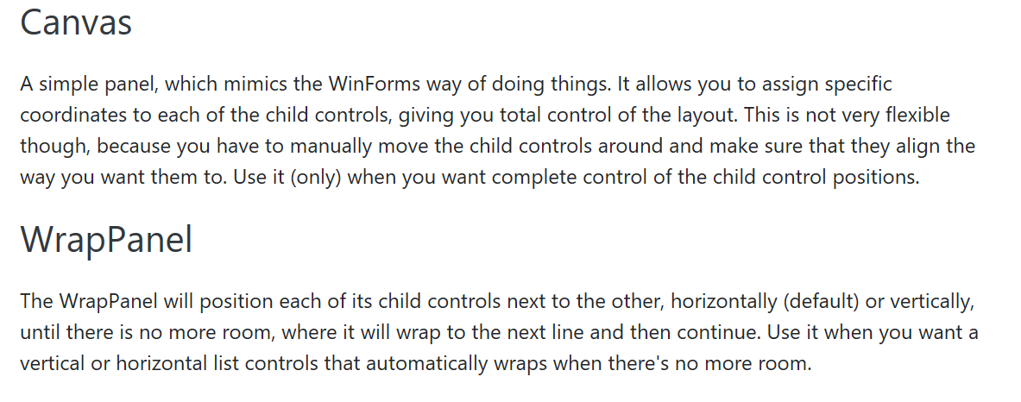

Slide 4
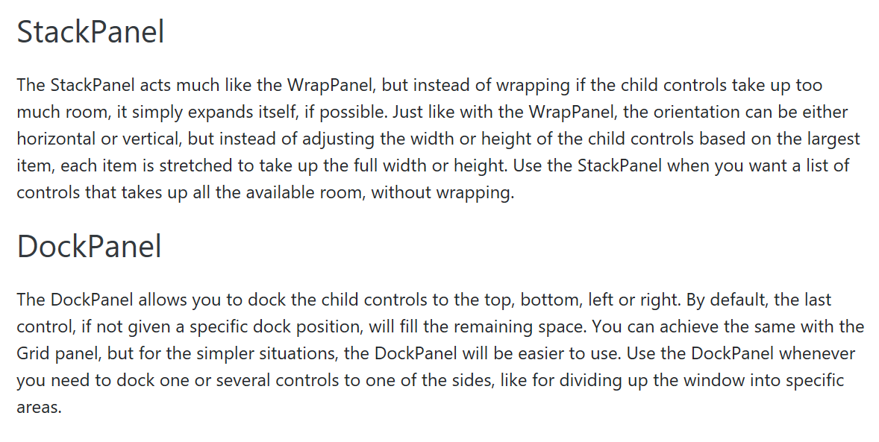

Slide 5
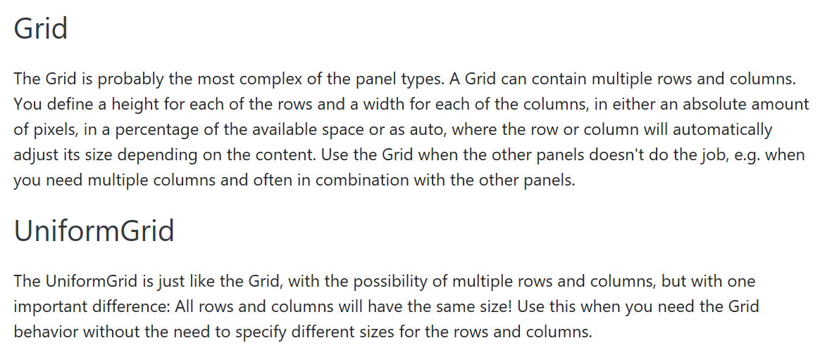

Slide 6
The Canvas control
The Canvas is probably the simplest Panel of them all. It doesn't really do anything by default, it just allows you to put controls in it and then position them yourself using explicit coordinates.

Slide 7
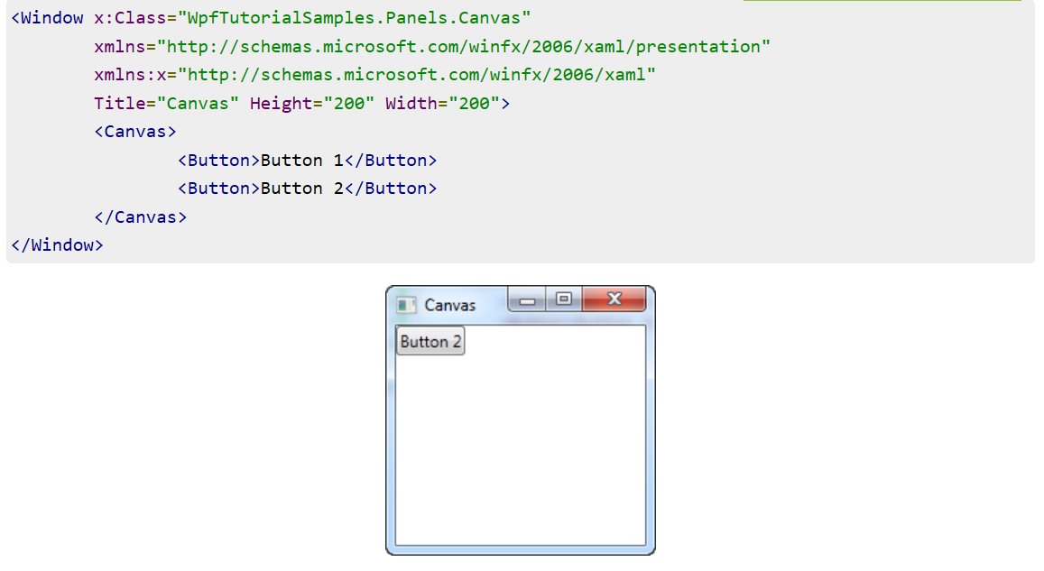

Slide 8
As you can see, even though we have two buttons, they are both placed in the exact same place, so only the last one is visible. The Canvas does absolutely nothing until you start giving coordinates to the child controls. This is done using the Left, Right, Top and Bottom attached properties from the Canvas control.
These properties allow you to specify the position relative to the four edges of the Canvas. By default, they are all set to NaN (Not a Number), which will make the Canvas place them in the upper left corner, but as mentioned, you can easily change this:

Slide 9
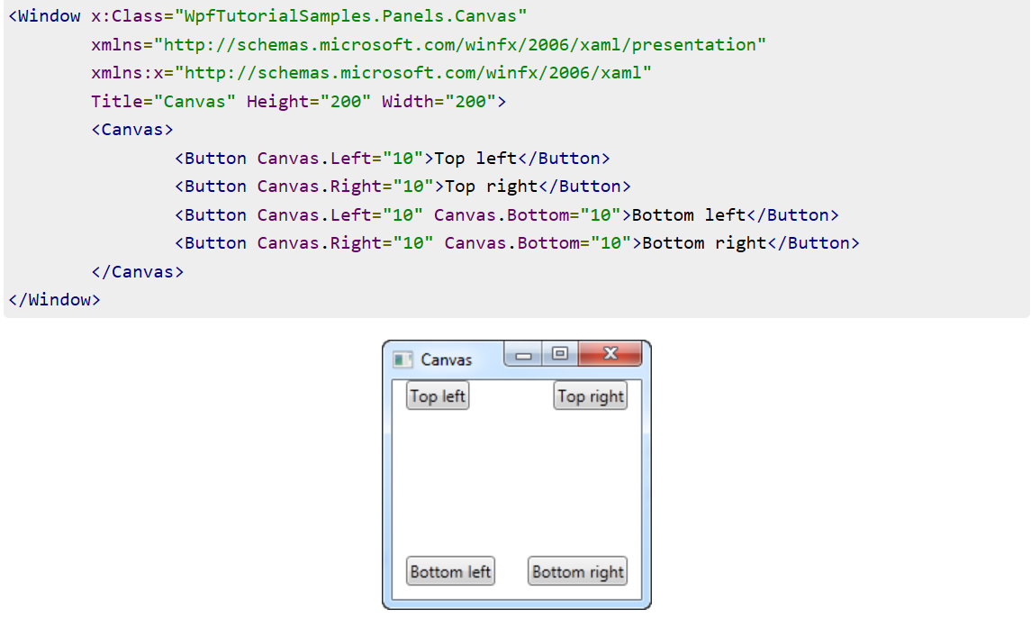

Slide 10
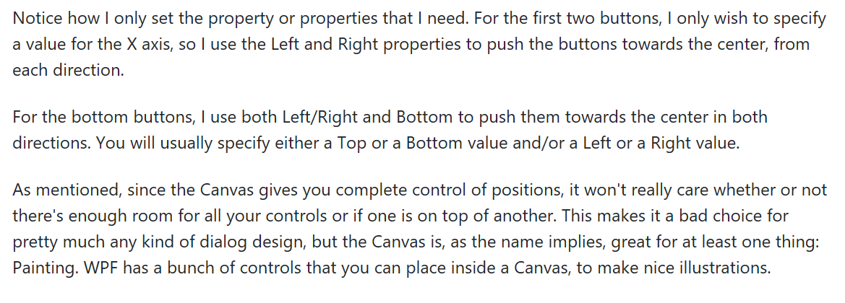

Slide 11
The WrapPanel control
The WrapPanel will position each of its child controls next to the other, horizontally (default) or vertically, until there is no more room, where it will wrap to the next line and then continue. Use it when you want a vertical or horizontal list controls that automatically wraps when there's no more room.
When the WrapPanel uses the Horizontal orientation, the child controls will be given the same height, based on the tallest item. When the WrapPanel is the Vertical orientation, the child controls will be given the same width, based on the widest item.

Slide 12
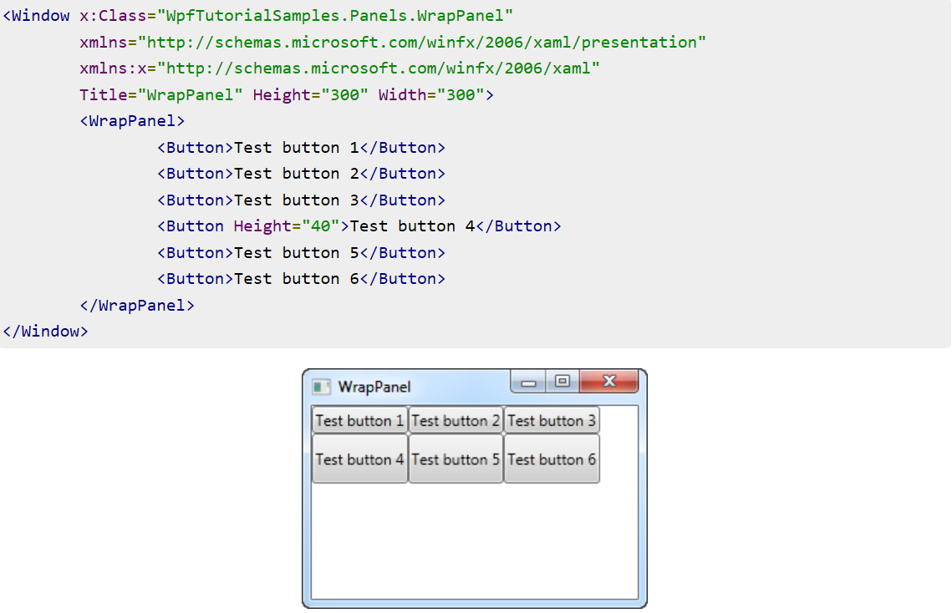

Slide 13
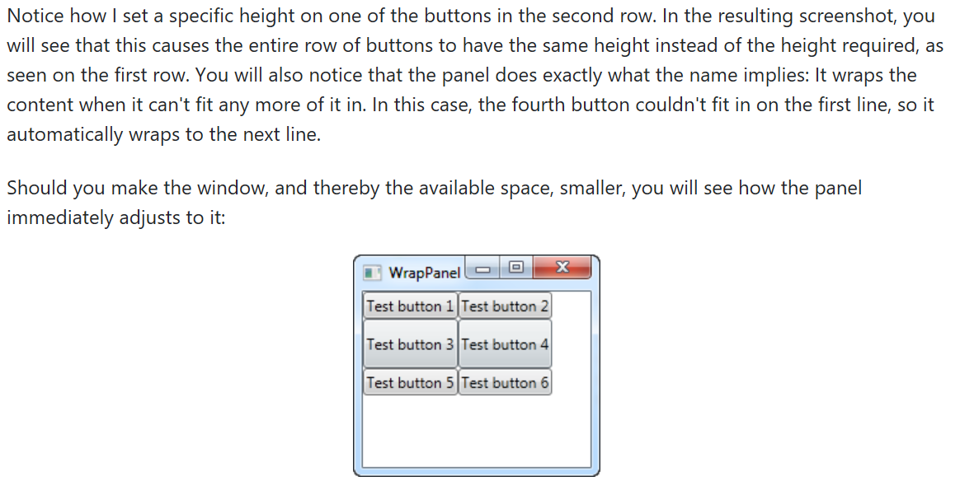

Slide 14
All of this behavior is also true when you set the Orientation to Vertical. The following slide has the exact same example as before, but with a Vertical WrapPanel

Slide 15
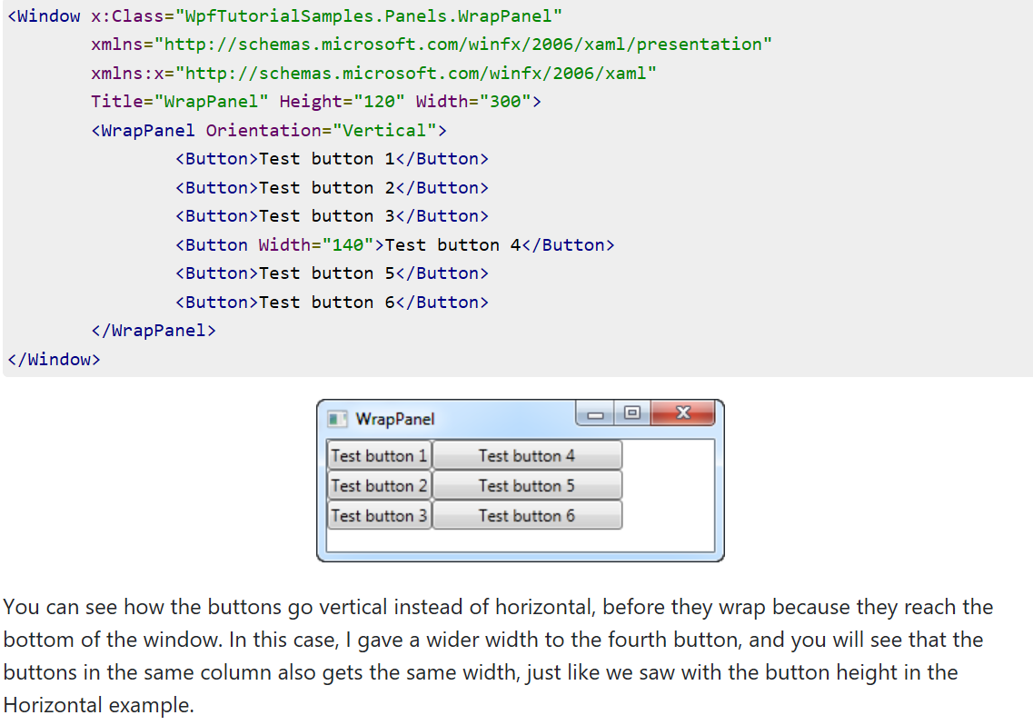

Slide 16
The StackPanel control
The StackPanel is very similar to the WrapPanel, but with at least one important difference: The StackPanel doesn't wrap the content. Instead it stretches it content in one direction, allowing you to stack item after item on top of each other. Let's first try a very simple example, much like we did with the WrapPanel:

Slide 17
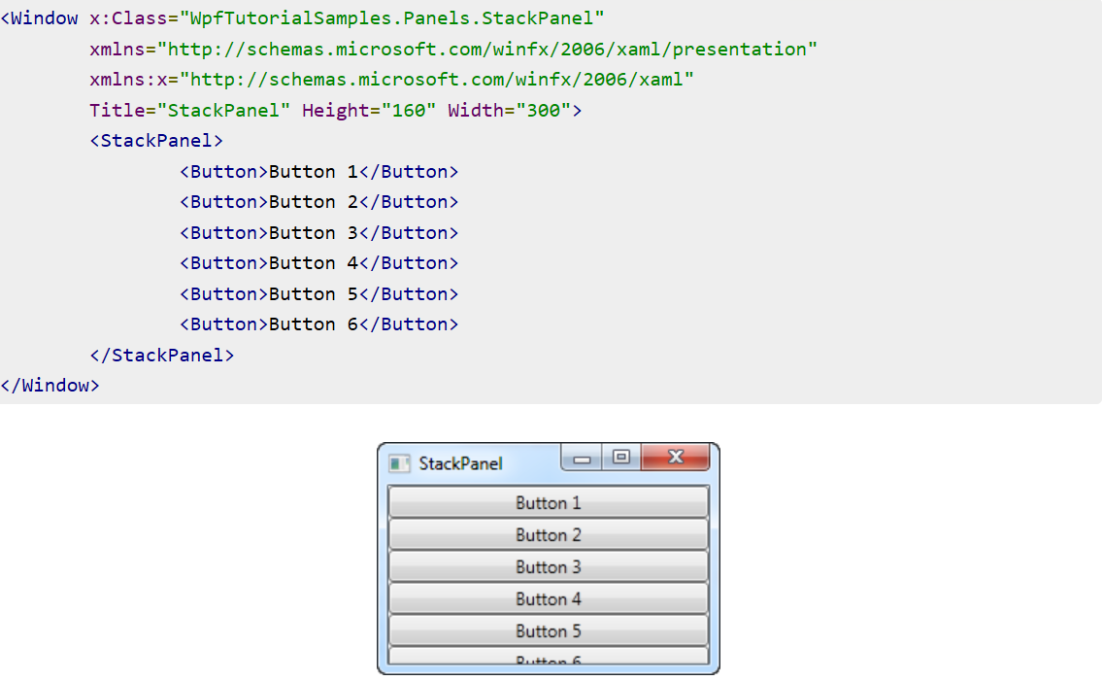

Slide 18
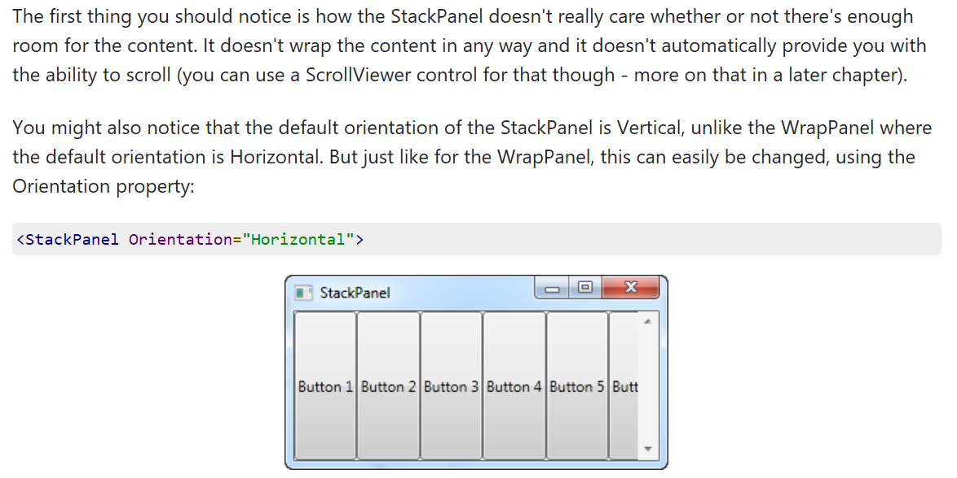

Slide 19
Another thing you will likely notice is that the StackPanel stretches its child control by default. On a vertically aligned StackPanel, like the one in the first example, all child controls get stretched horizontally. On a horizontally aligned StackPanel, all child controls get stretched vertically, as seen above. The StackPanel does this by setting the HorizontalAlignment or VerticalAlignment property on its child controls to Stretch, but you can easily override this if you want to. Have a look at the next example, where we use the same markup as we did in the previous example, but this time we assign values to the VerticalAlignment property for all the child controls:

Slide 20
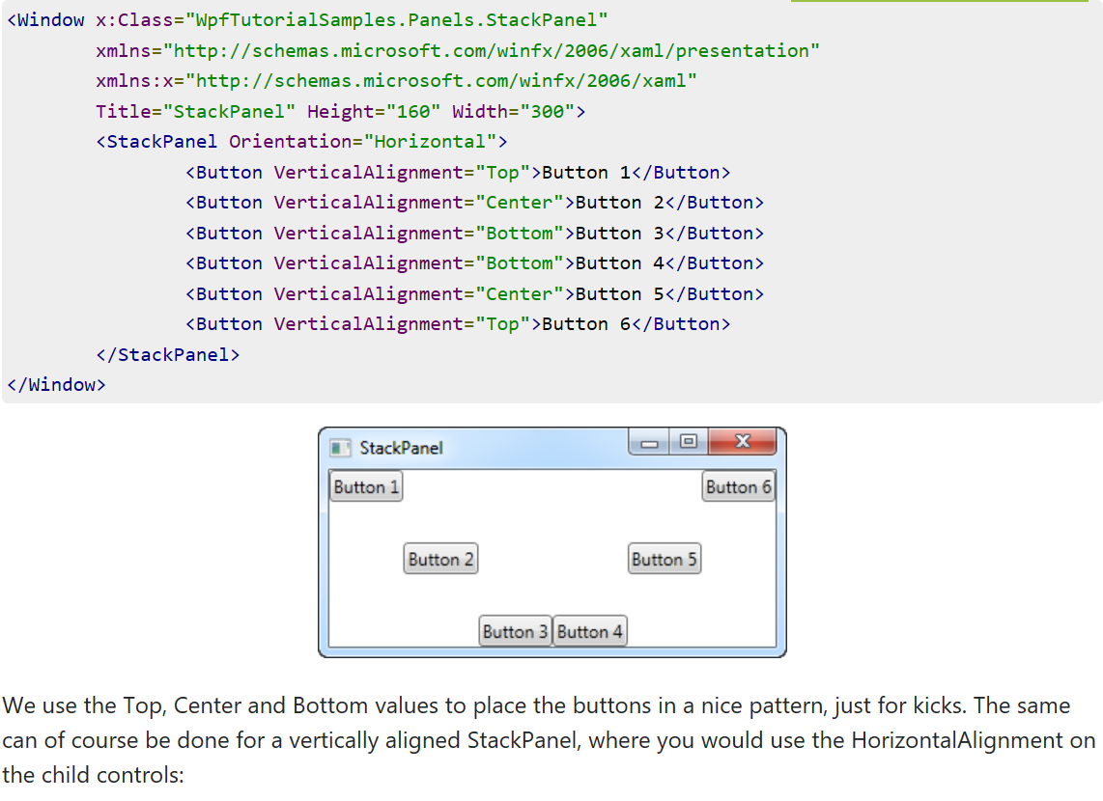

Slide 21
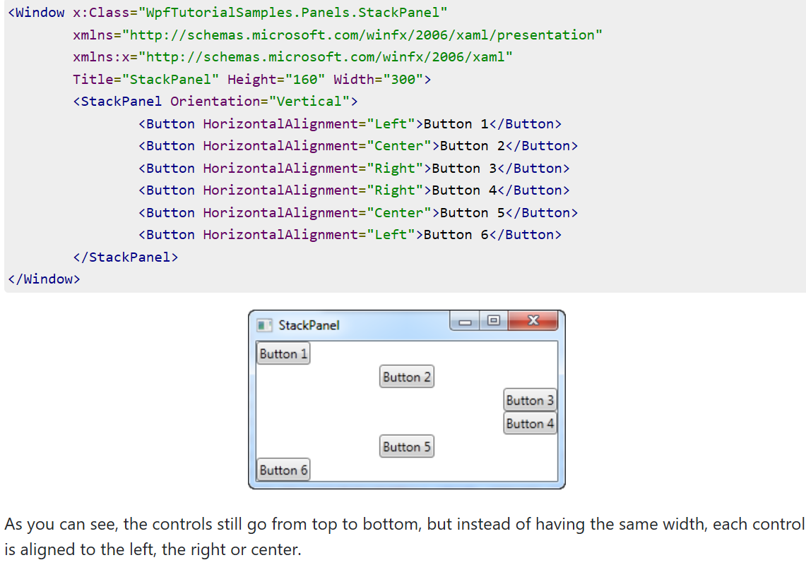

Slide 22
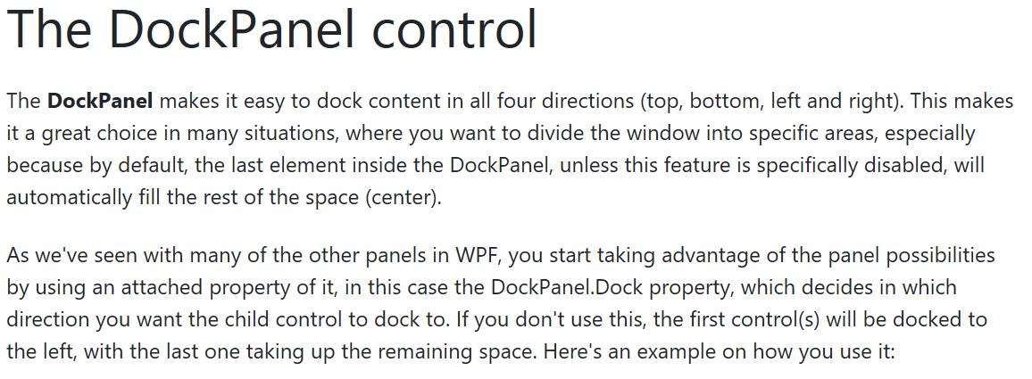

Slide 23
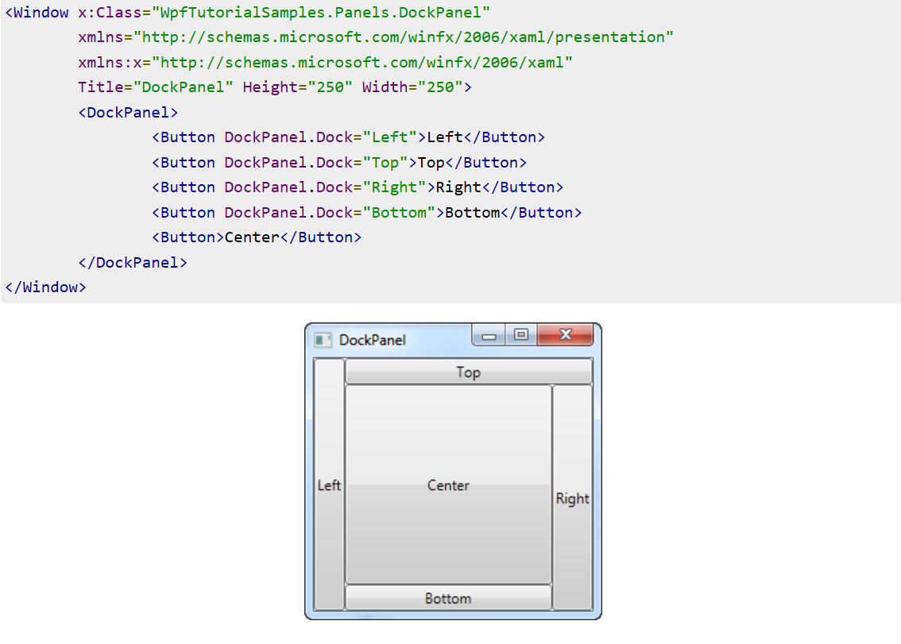

Slide 24
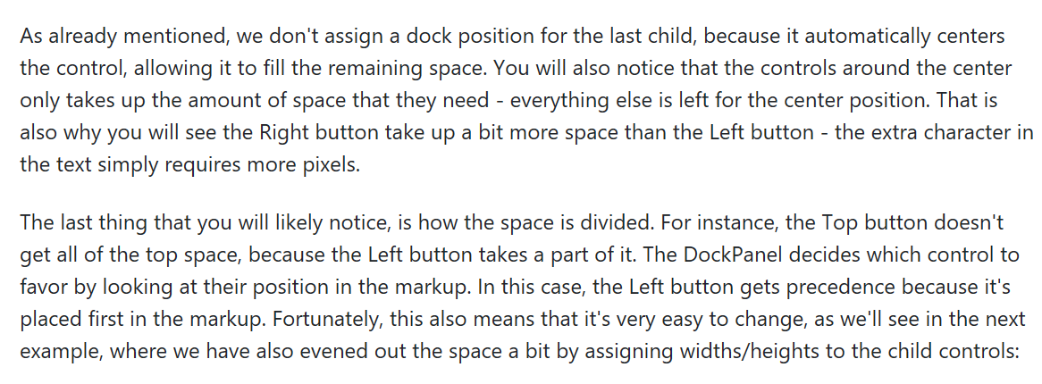

Slide 25
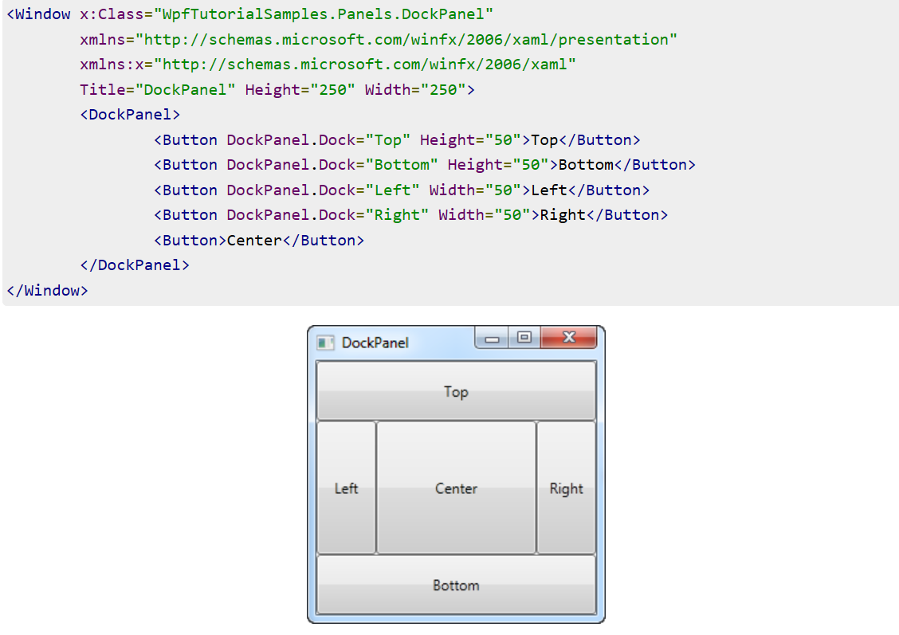

Slide 26
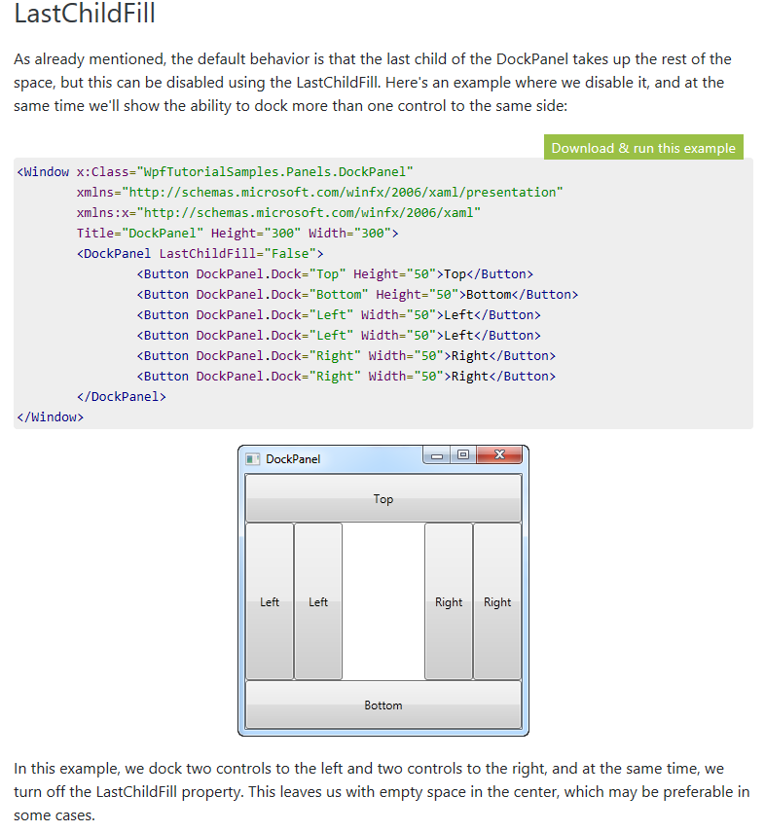

Slide 27
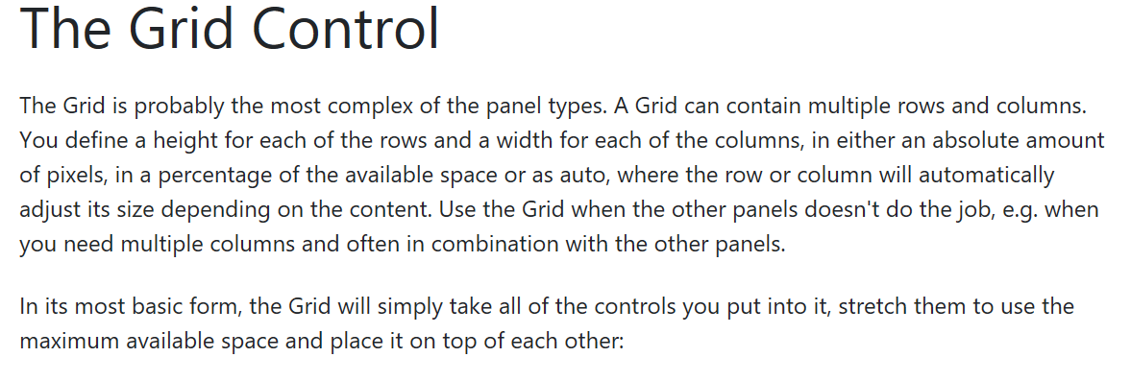

Slide 28
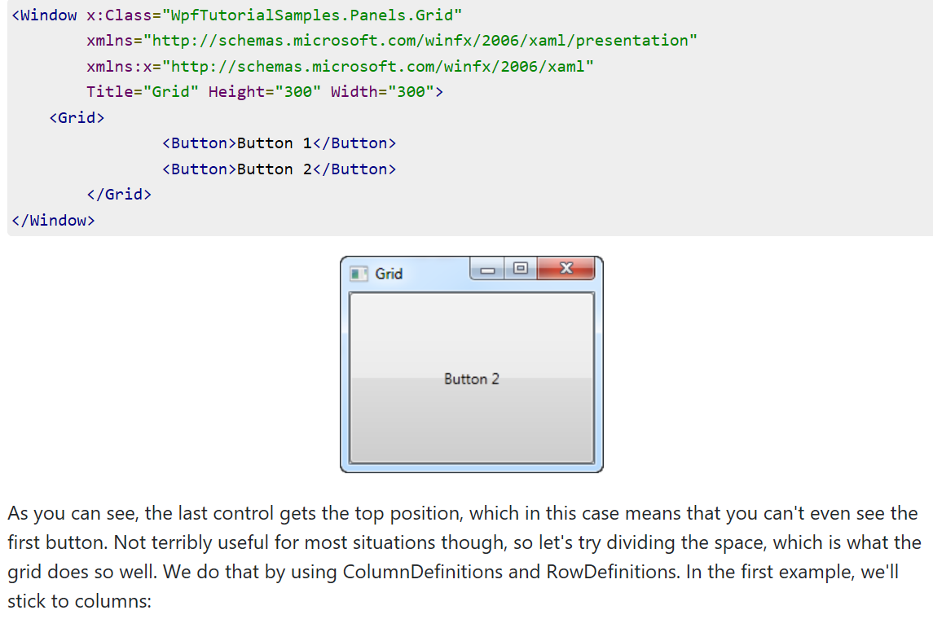

Slide 29
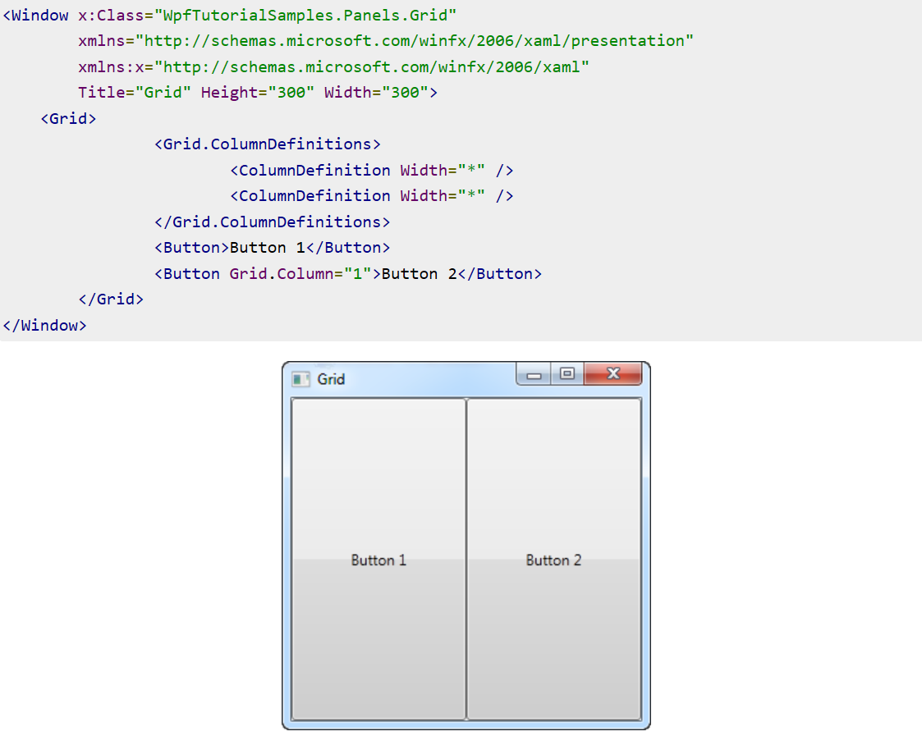

Slide 30
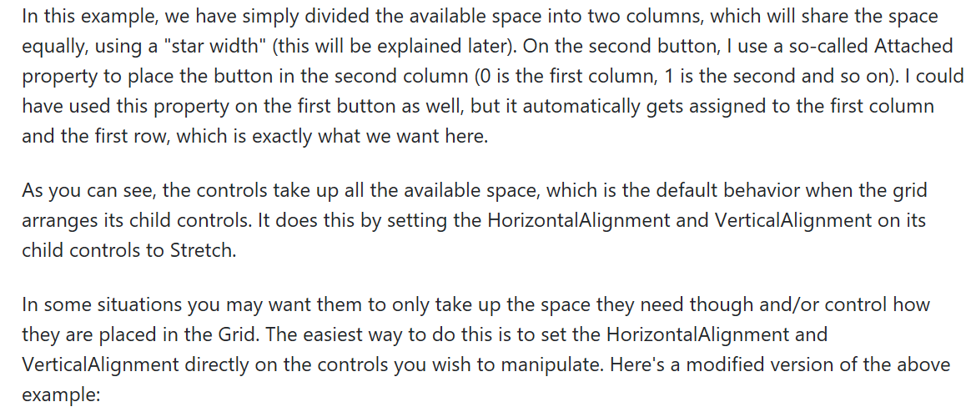

Slide 31
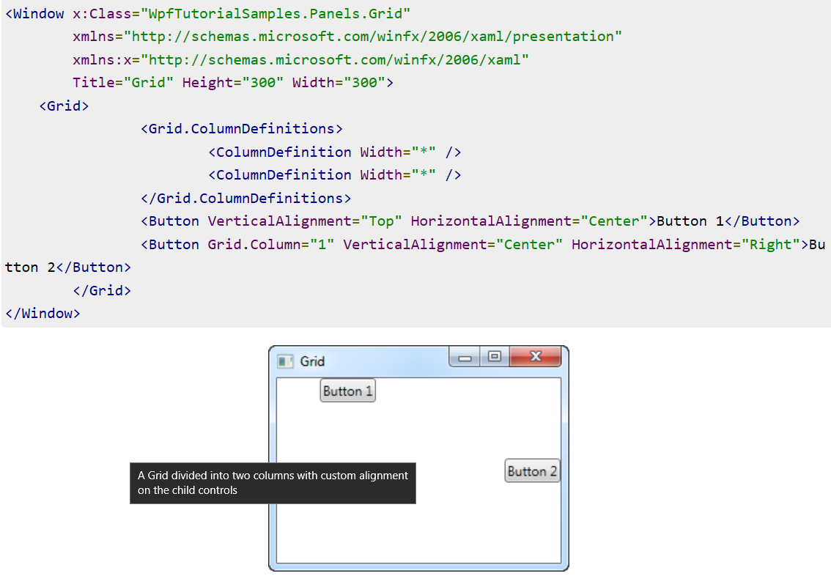

Slide 32
The Grid - Rows & columns
In the last chapter, we introduced you to the great Grid panel and showed you a couple of basic examples on how to use it. In this chapter we will do some more advanced layouts, as this is where the Grid really shines. First of all, let's throw in more columns and even some rows, for a true tabular layout

Slide 33
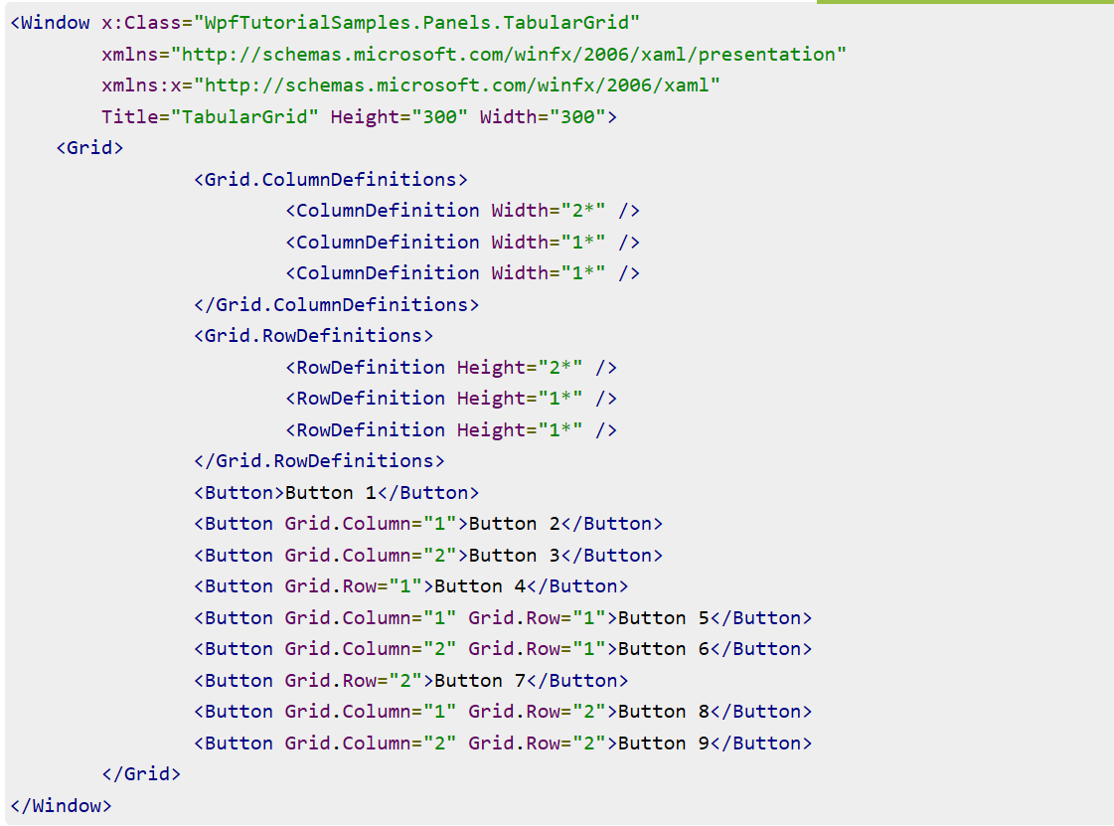

Slide 34
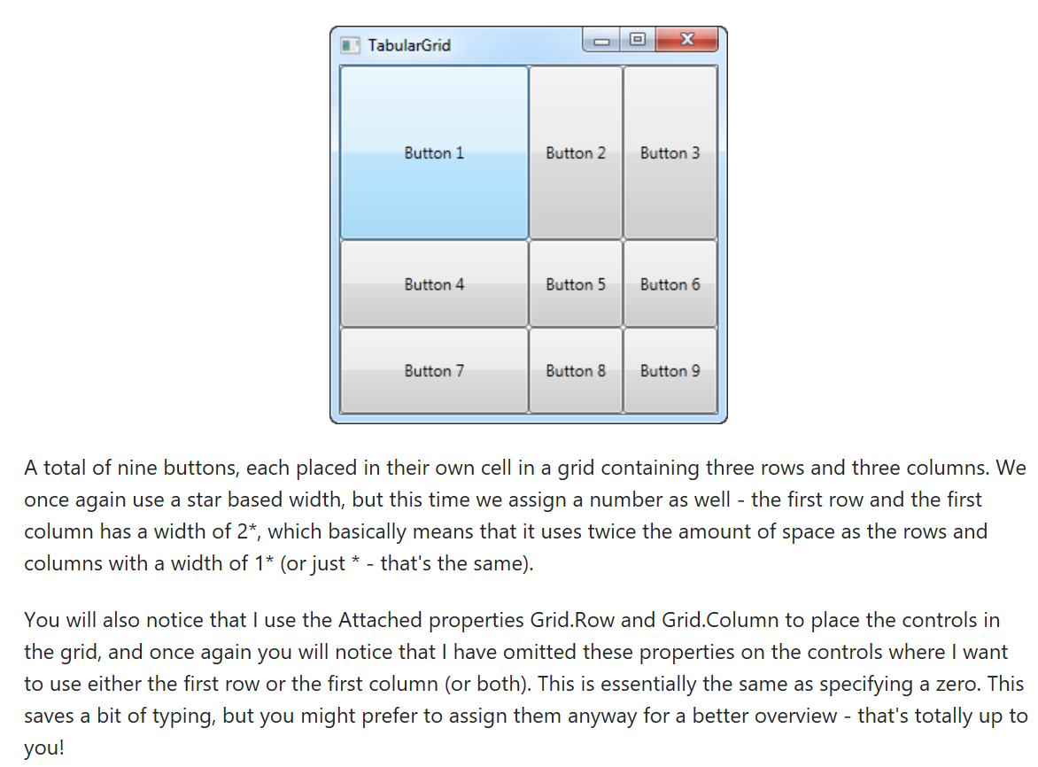

Slide 35
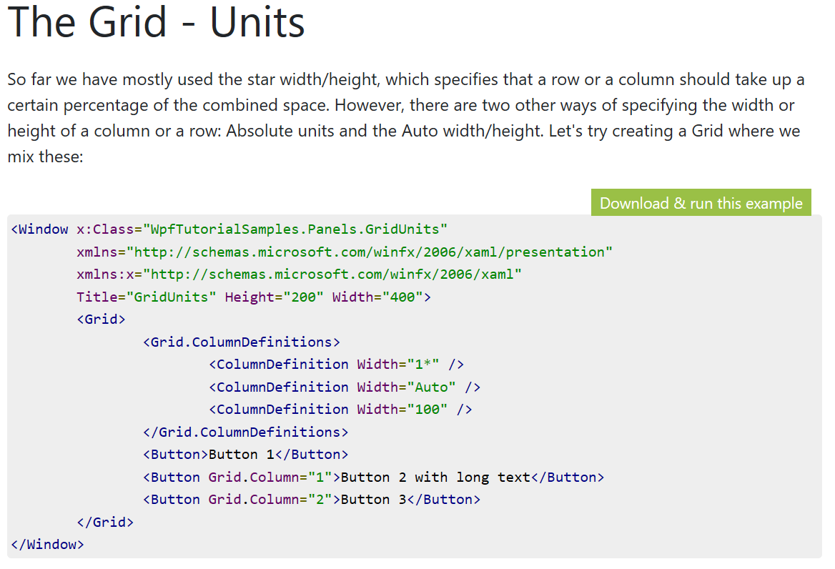

Slide 36
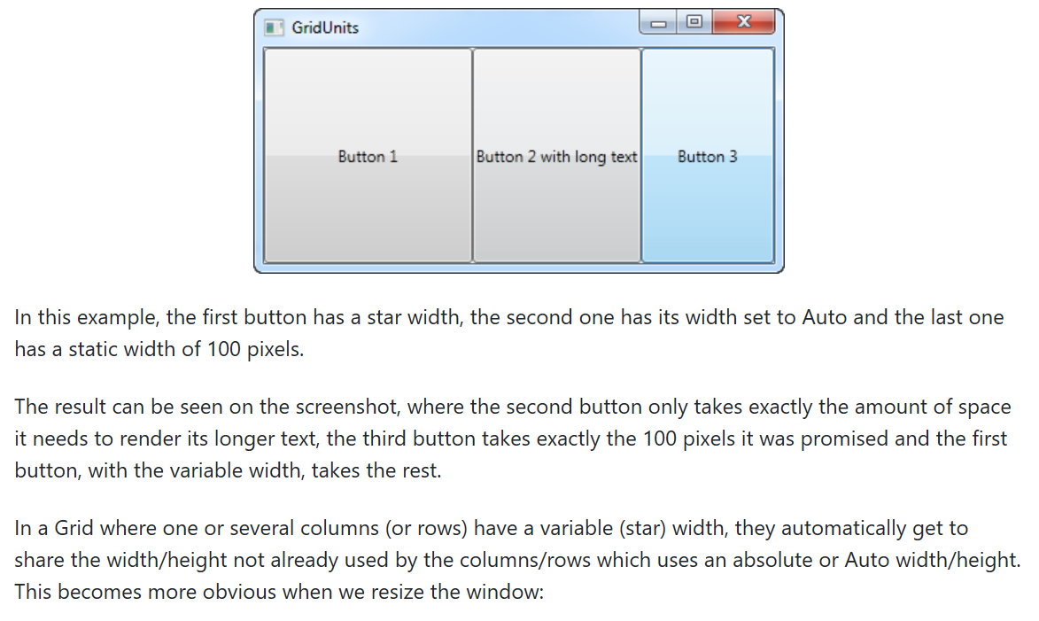

Slide 37
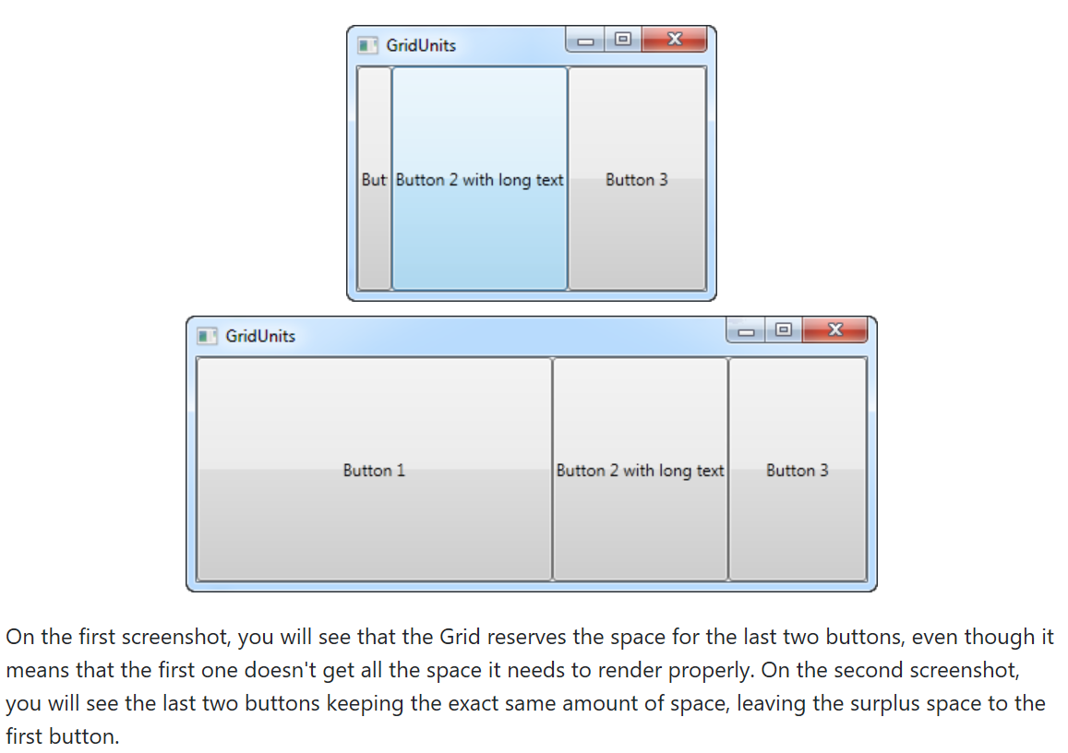

Slide 38
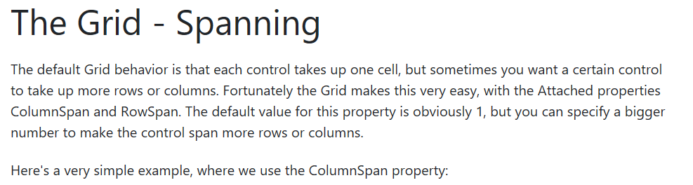

Slide 39
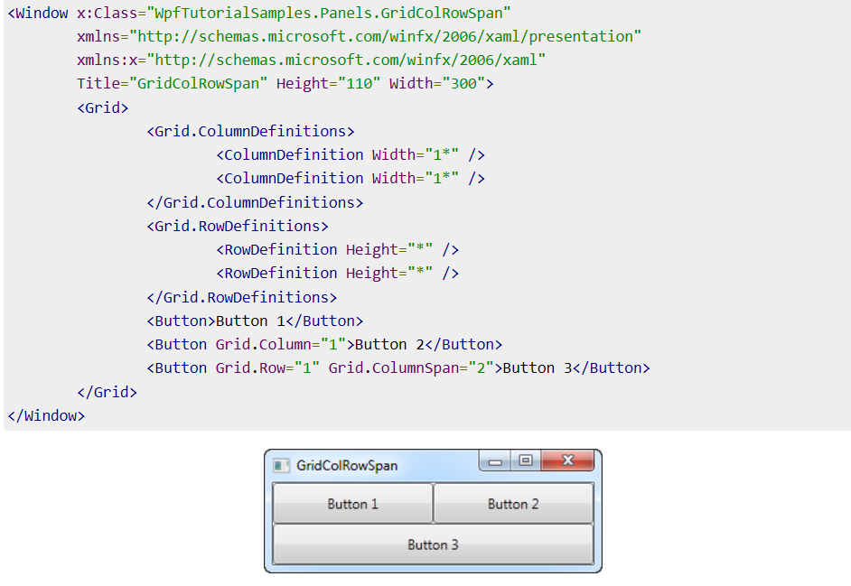

Slide 40
We just define two columns and two rows, all of them taking up their equal share of the place. The first two buttons just use the columns normally, but with the third button, we make it take up two columns of space on the second row, using the ColumnSpan attribute.
This is all so simple that we could have just used a combination of panels to achieve the same effect, but for just slightly more advanced cases, this is really useful. Let's try something which better shows how powerful this is:

Slide 41
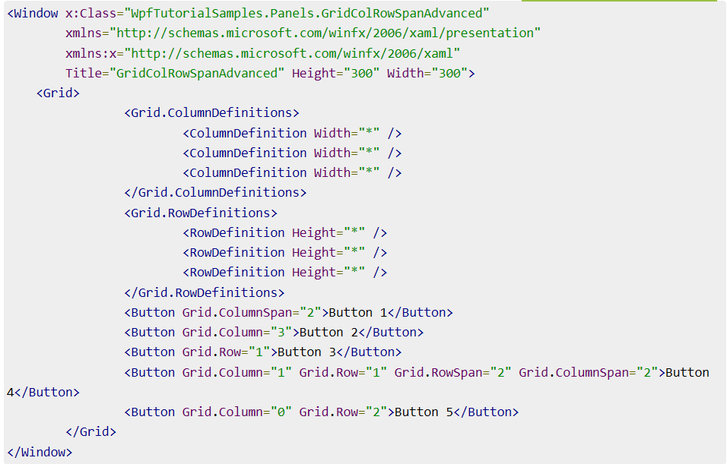

Slide 42
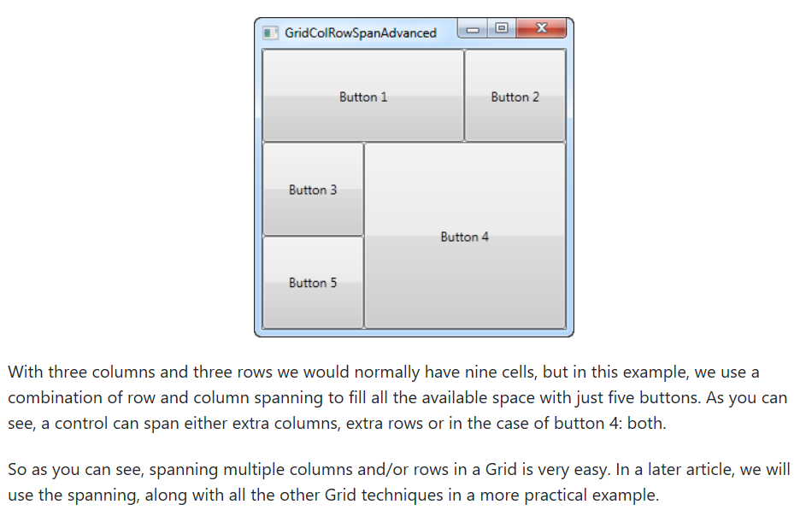

Slide 43
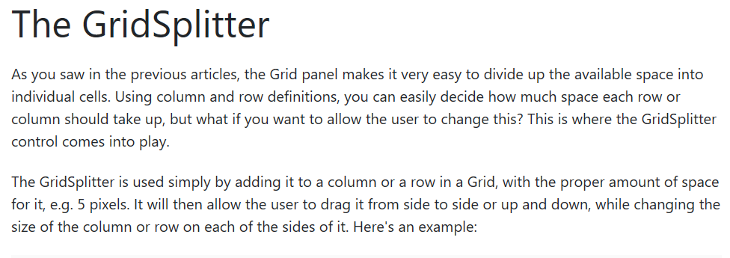

Slide 44
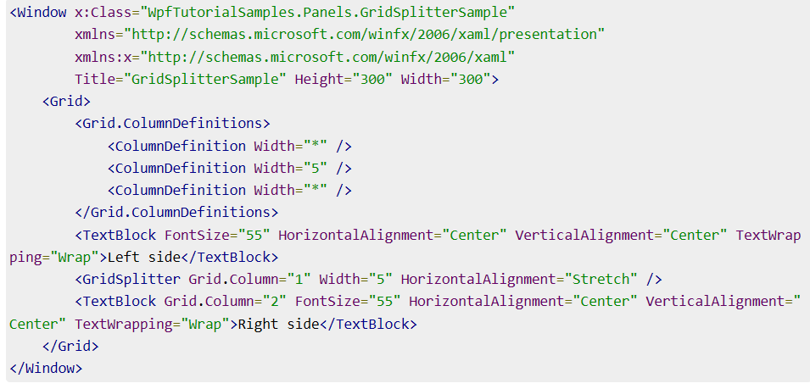

Slide 45
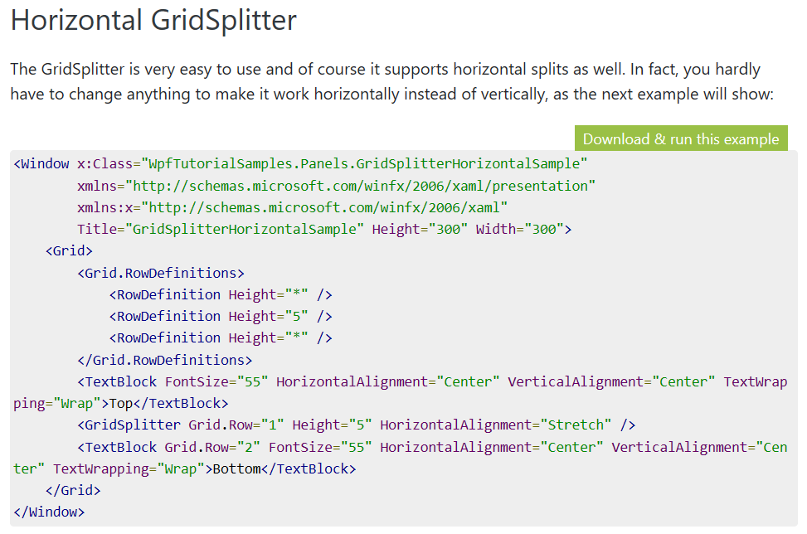

Slide 46
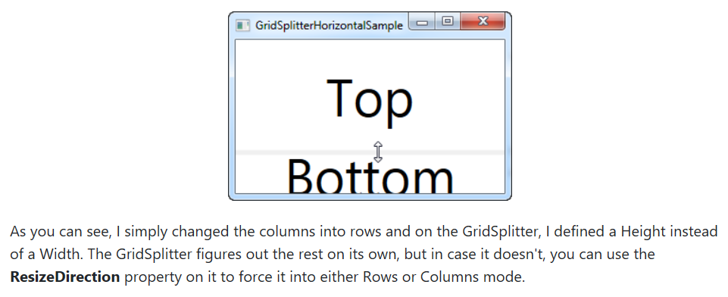

Slide 47
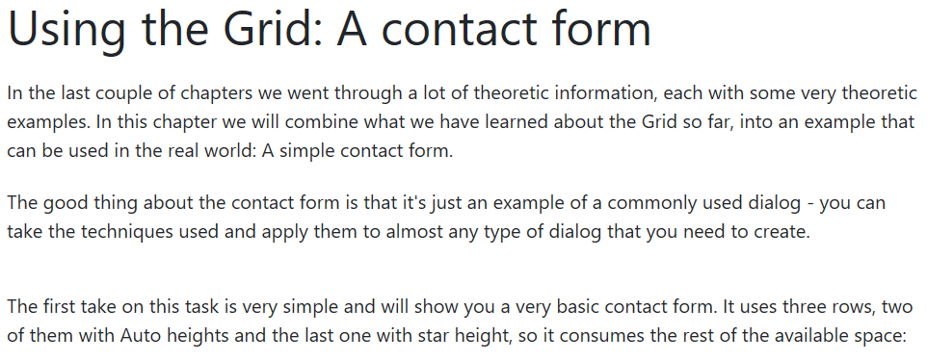

Slide 48
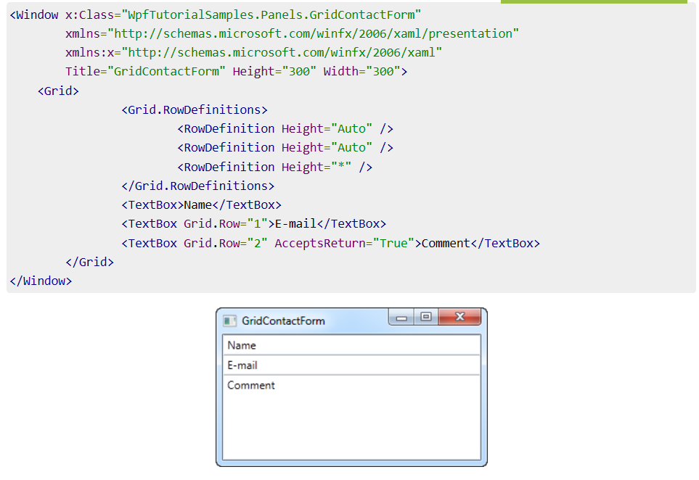

Slide 49
As you can see, the last TextBox simply takes up the remaining space, while the first two only takes up the space they require. Try resizing the window and you will see the comment TextBox resize with it.
In this very simple example, there are no labels to designate what each of the fields are for. Instead, the explanatory text is inside the TextBox, but this is not generally how a Windows dialog looks. Let's try improving the look and usability a bit:

Slide 50
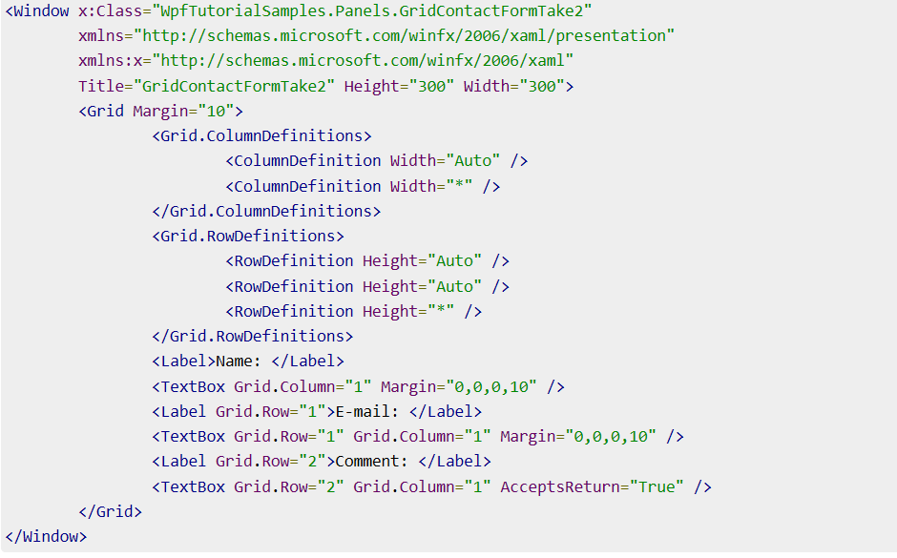

Slide 51
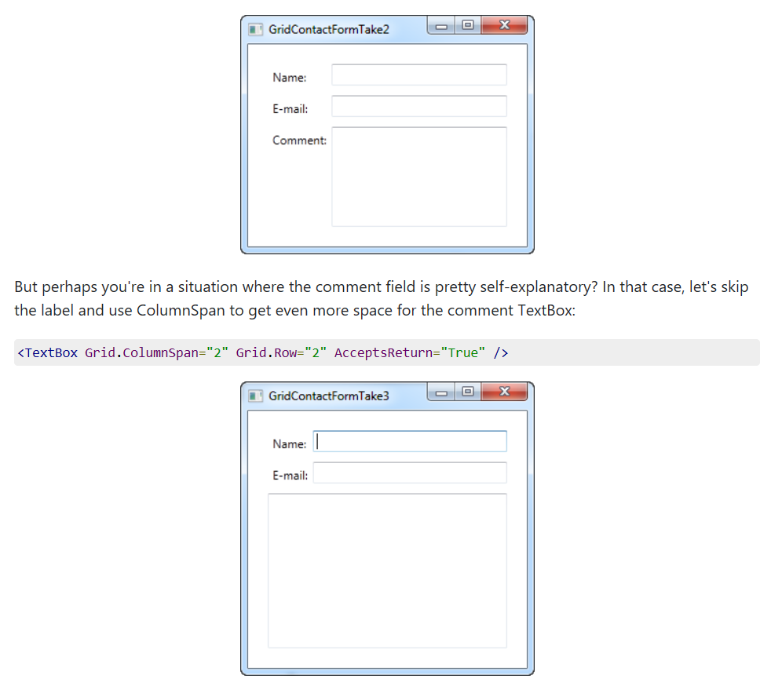

Slide 52
So as you can see, the Grid is a very powerful panel. Hopefully you can use all of these techniques when designing your own dialogs.

Slide 53
Thank You!
Ooko, 12th March 2019

